Slide 1
Days of the week
Mr Greg’s English Cloud

Slide 2
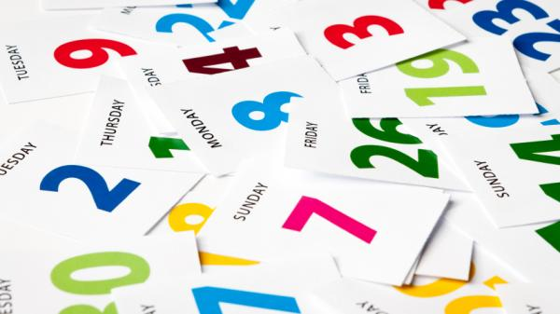
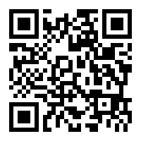
Days of the Week
Monday
Tuesday
Wednesday
Thursday
Friday
Saturday
Sunday

Slide 3
Before and After
Before
Monday
Tuesday
Wednesday
Thursday
Friday
Saturday
Sunday
After
Monday
Tuesday
Wednesday
Thursday
Friday
Saturday
Sunday

Slide 4
What day comes after Monday?
Tuesday!
Monday
Tuesday
Wednesday
Thursday
Friday
Saturday
Sunday

Slide 5
What day comes after Wednesday?
Thursday!
Monday
Tuesday
Wednesday
Thursday
Friday
Saturday
Sunday

Slide 6
What day comes after Saturday?
Sunday!
Monday
Tuesday
Wednesday
Thursday
Friday
Saturday
Sunday

Slide 7
What day comes before Tuesday?
Monday!
Monday
Tuesday
Wednesday
Thursday
Friday
Saturday
Sunday

Slide 8
What day comes before Thursday?
Wednesday!
Monday
Tuesday
Wednesday
Thursday
Friday
Saturday
Sunday

Slide 9
What day comes before Sunday?
Saturday!
Monday
Tuesday
Wednesday
Thursday
Friday
Saturday
Sunday

