Slide 1
What am i?
Mr Greg’s English Cloud

Slide 2
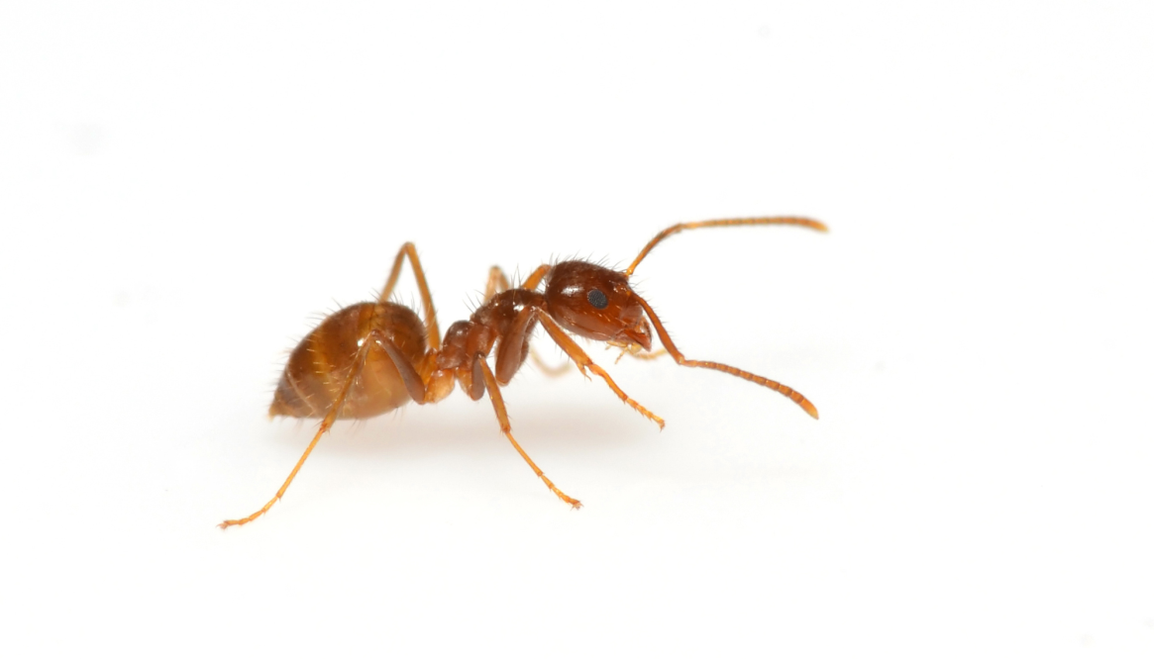
What am I?
I am small.
I am an insect.
I am strong.
I live in a hill.
I am an ant!

Slide 3
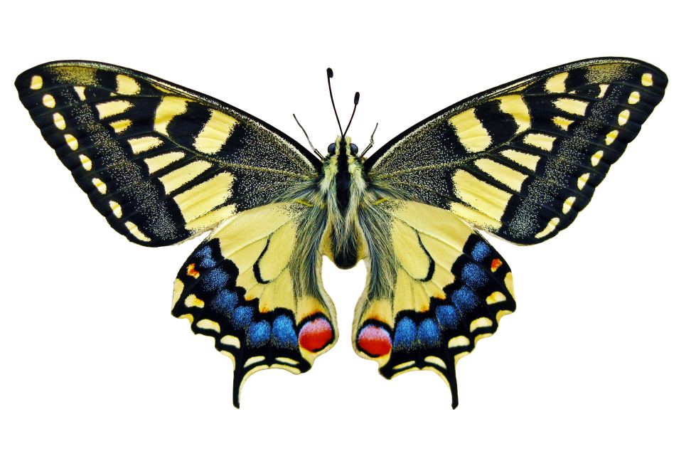
What am I?
I have wings.
My wings have many different colours and patterns.
I can fly.
I used to be a caterpillar.
I am a butterfly!

Slide 4
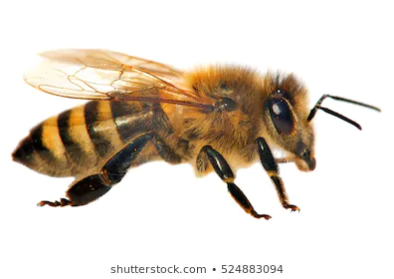
What am I?
I am black and yellow.
I have wings.
I can fly.
I live in a hive.
I can make honey!
I am a bee!

Slide 5
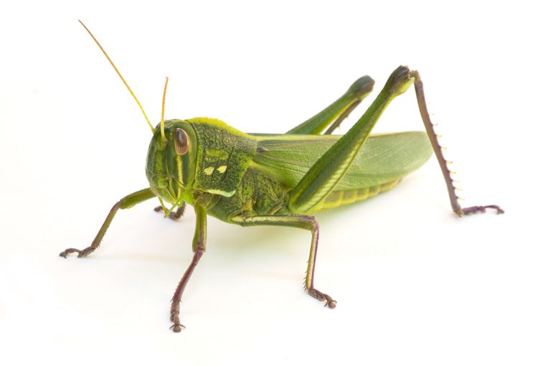
What am I?
I am green.
I have a long body.
I have two long back legs.
I can make noises with my legs.
I can hop!
I am a grasshopper!

Slide 6
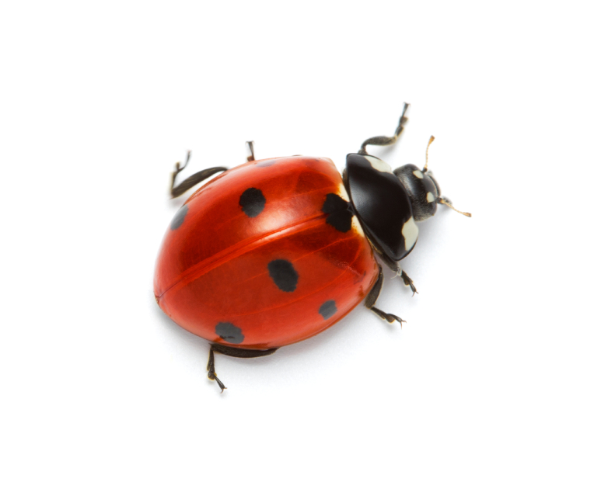
What am I?
I am red with black spots.
I have wings.
I can fly.
I am small.
I am a ladybug!

Slide 7
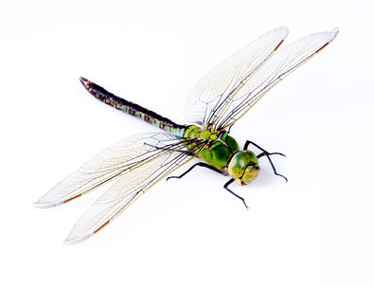
What am I?
I have four wings.
I can fly very fast.
I have a long body.
I like being near water.
I am a dragonfly!

Slide 8
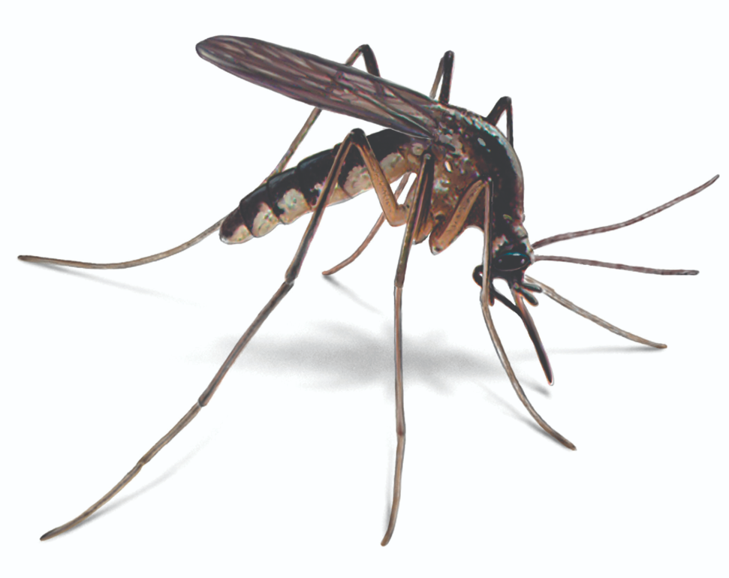
What am I?
I can fly.
I have long legs.
I have a long mouth called a proboscis.
I like warm weather.
I can bite you.
I am a mosquito!

Slide 9
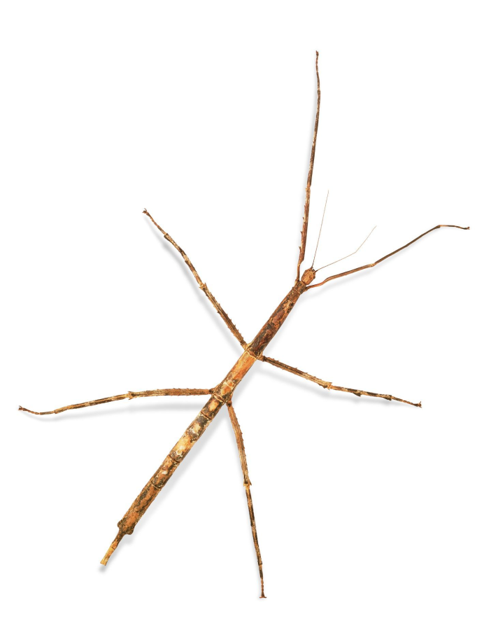
What am I?
I am thin.
I have a long body and legs.
I don’t move much.
I like plants.
It is hard to find me.
I am a stick insect!

Slide 10
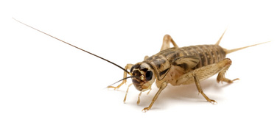
What am I?
I am brown.
I have strong back legs.
I am like going out at night.
I make sounds with my wings.
I am a cricket!

