Slide 1
What am I?
Mr Greg’s English Cloud

Slide 2
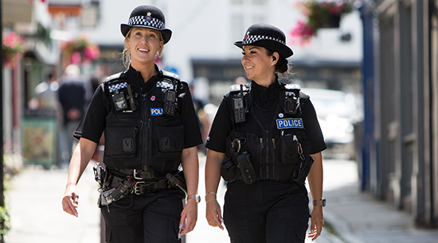
What am I?
I work in a station.
I like to help other people.
I help maintain order.
I have a uniform.
I am a police officer!

Slide 3

What am I?
I work in a hospital.
I like to help people.
I help people get better.
I can give you medicine.
I am a doctor!

Slide 4
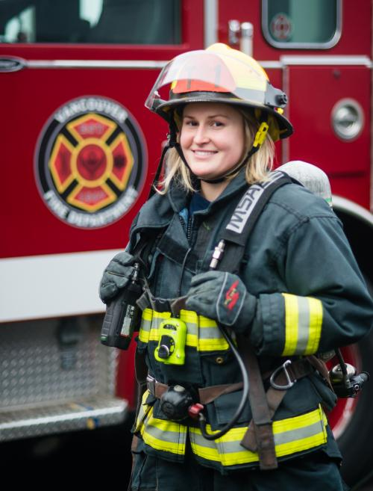
What am I?
I work in a station.
I like to help other people.
I help to put out fires.
I drive a truck.
I am a firefighter!

Slide 5
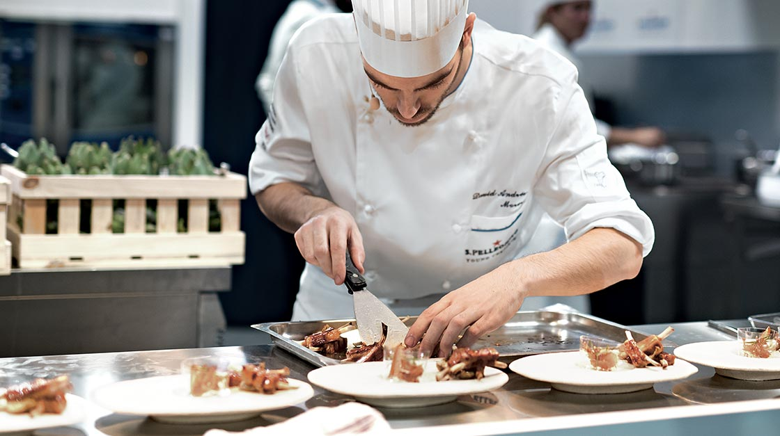
What am I?
I work in a kitchen.
I like to cook food.
I work in a restaurant.
I am a chef!

Slide 6
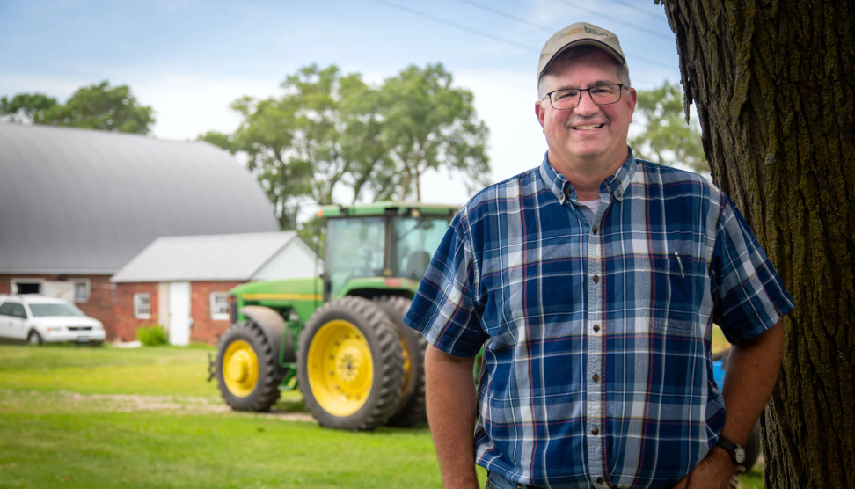
What am I?
I work on a farm.
I grow vegetables.
I look after animals.
I drive a tractor.
I am a farmer!

Slide 7
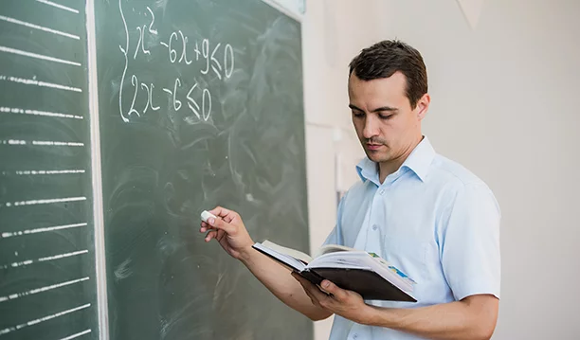
What am I?
I work in a school.
I help students learn new things.
I use a whiteboard at work.
I am a teacher!

Slide 8
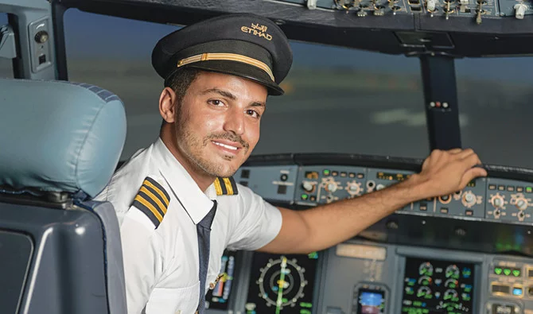
What am I?
I work in an airport.
I help people get to their destination.
I can fly planes.
I wear a uniform.
I am a pilot!

Slide 9
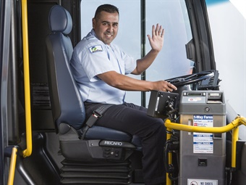
What am I?
I drive a vehicle.
The vehicle can hold many people.
I stop the vehicle at a station.
I can drive to school.
I am a bus driver!

Slide 10
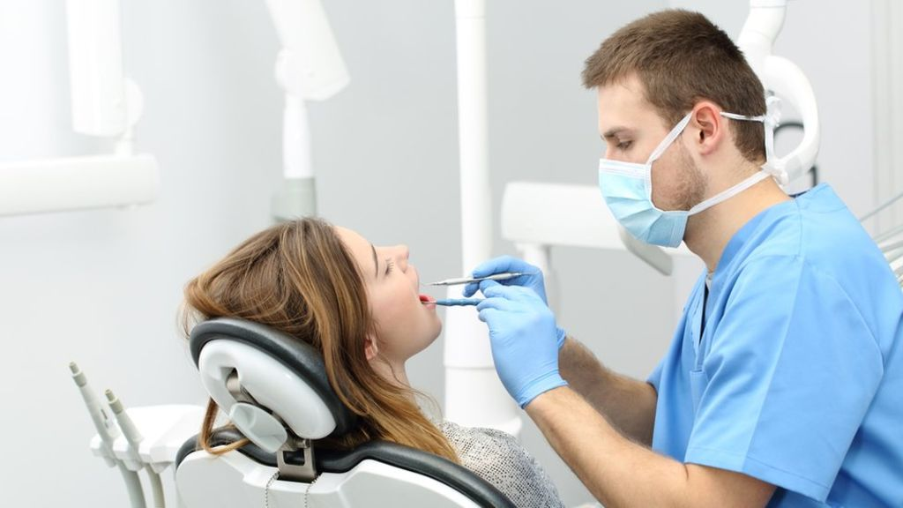
What am I?
I work in a surgery.
I work with teeth.
I like to help other people.
I am a dentist!

Slide 11
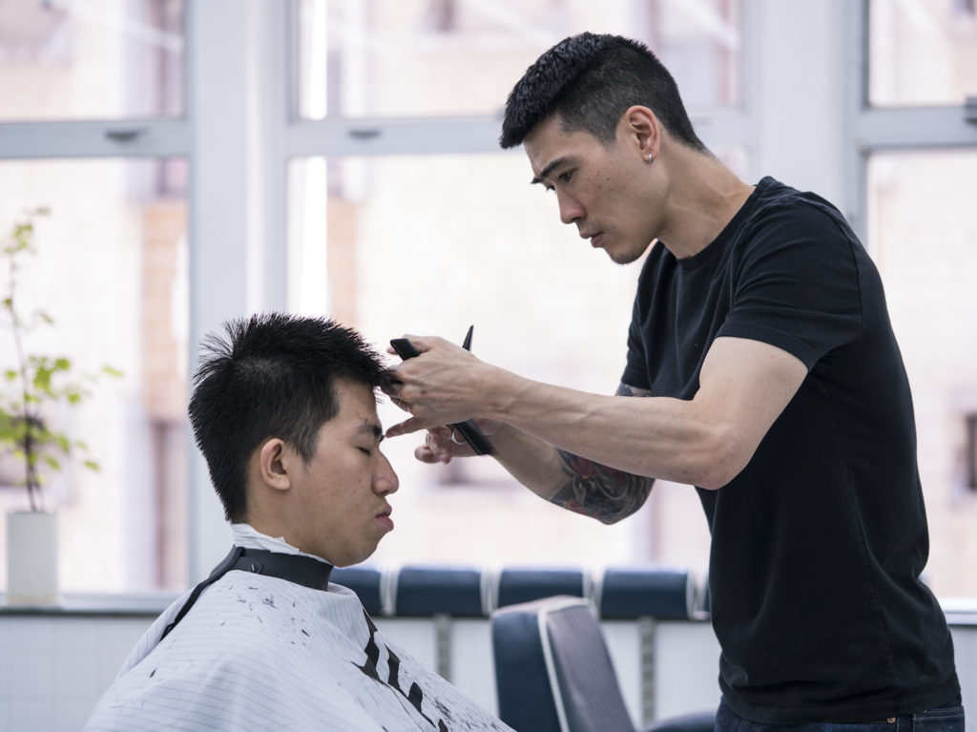
What am I?
I work in a shop.
I like to cut and style hair.
I use scissors in my job.
I am a barber/hair dresser!

