Slide 1
What IS IT?
Mr Greg’s English Cloud

Slide 2
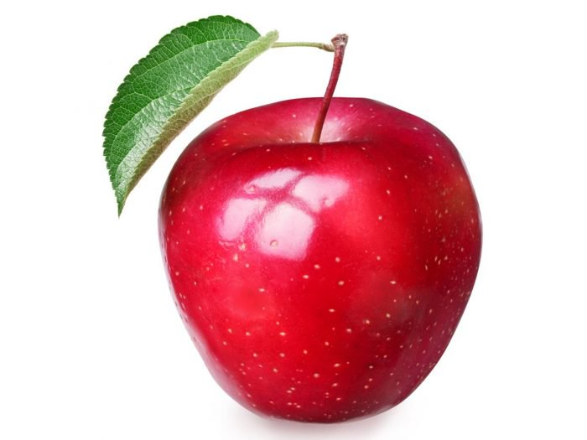
What is it?
It can be red or green.
It grows on trees.
It is round.
It is a hard fruit.
It is an apple!

Slide 3
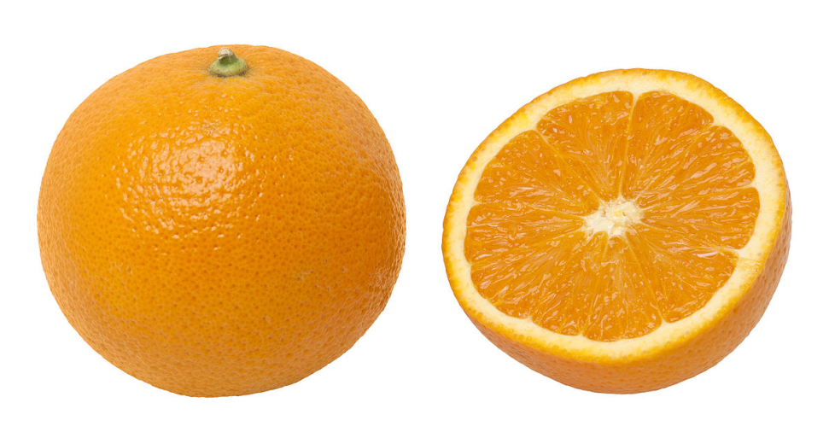
What is it?
It is orange.
It grows on trees.
It is round.
You need to peel it.
It is soft inside.
It is an orange!

Slide 4
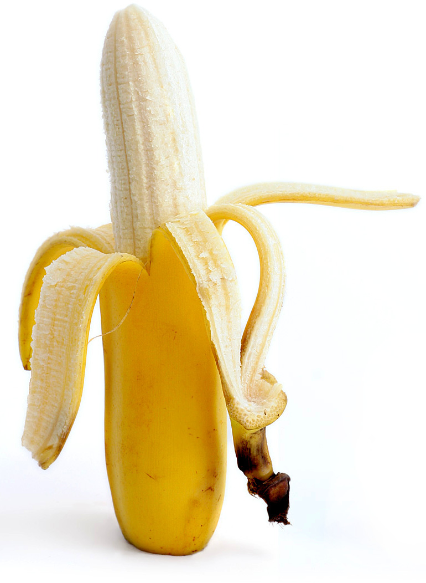
What is it?
It is yellow.
It grows on trees.
It is long.
You need to peel it.
It is soft inside.
It is a banana!

Slide 5
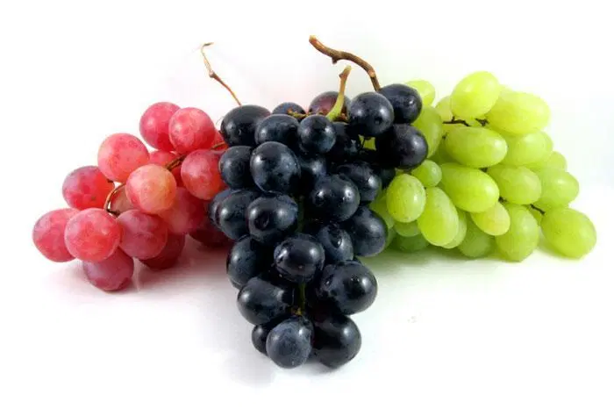
What is it?
It can be green, red or purple.
It grows on vines.
It is round.
It is small.
It is a soft fruit.
It is a grape!

Slide 6
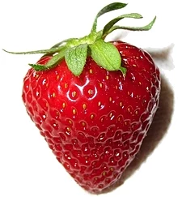
What is it?
It is red.
It grows on runners.
It is round.
It is small.
It is a soft fruit.
It is a strawberry!

Slide 7
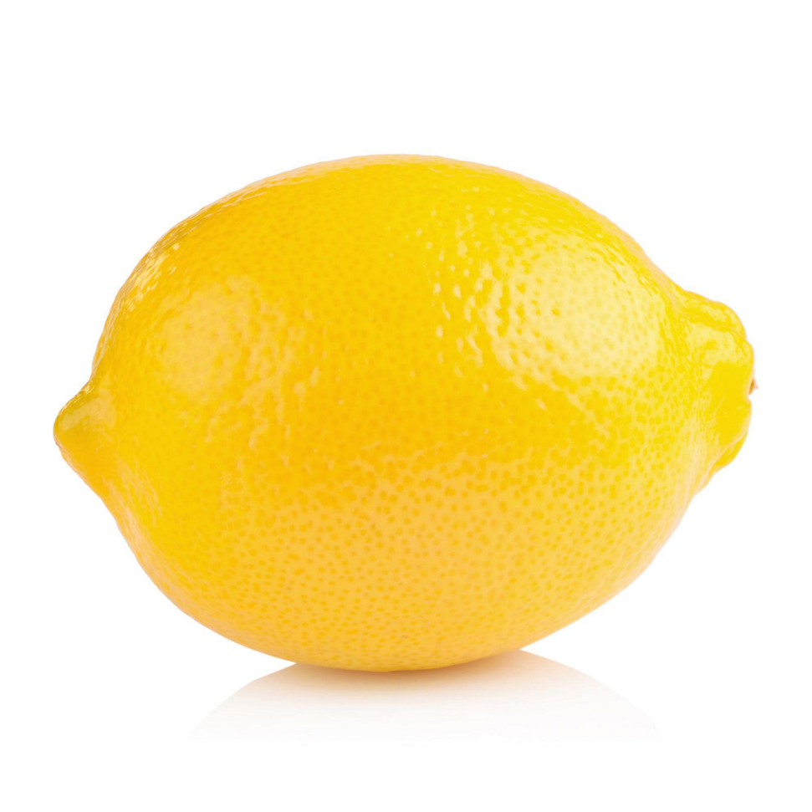
What is it?
It is yellow.
It grows on trees.
It is round.
It is sour.
It is a soft fruit.
It is a lemon!

Slide 8
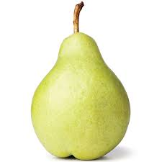
What is it?
It is green.
It grows on trees.
It is round.
It has a unique shape.
It is a pear!

Slide 9
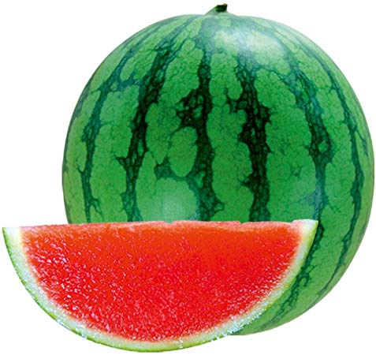
What is it?
It is green on the outside
It is red on the inside.
It grows on vines.
It is big and round.
It is soft on the inside.
It is a watermelon!

Slide 10
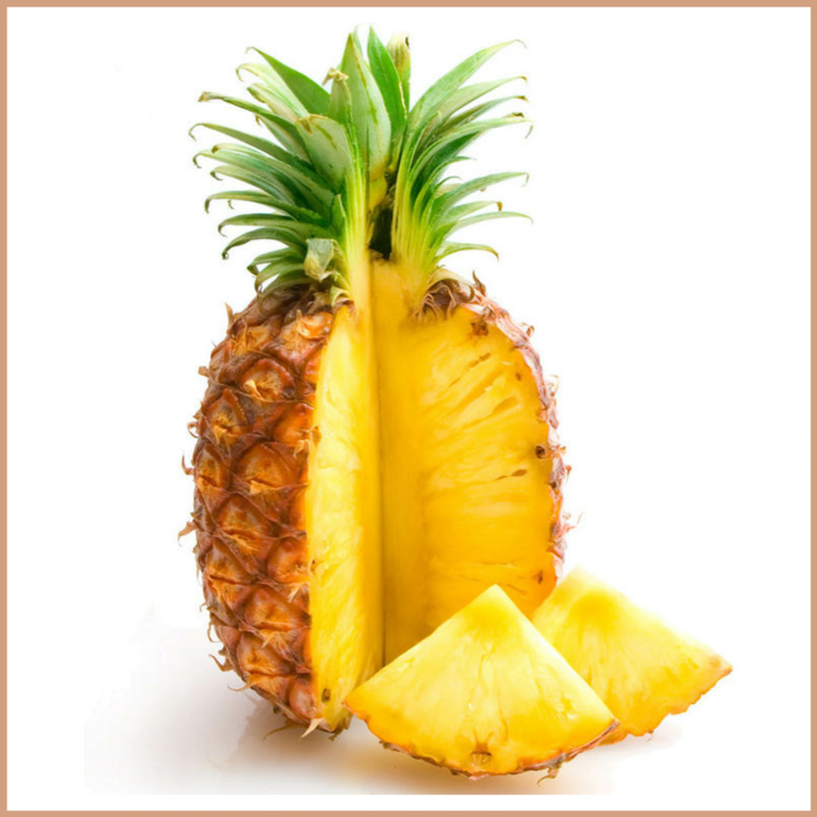
What is it?
It is yellow on the inside.
It grows on trees.
It has leaves coming out of it’s top.
It is spiky.
It is a soft fruit
It is a pineapple!

Slide 11
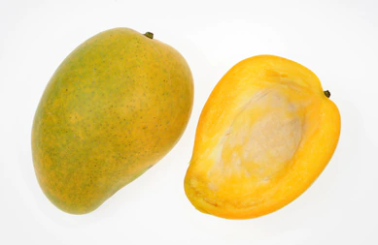
What is it?
It is yellow or orange.
It grows on trees.
It is round.
It has a big seed inside of it.
It is a hard fruit.
It is a mango!

Slide 12
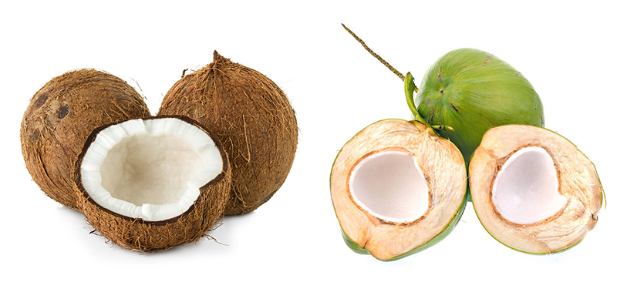
What is it?
It can be green or brown.
It is white on the inside.
It is round.
It is hard.
It has water inside.
It is a coconut!

Slide 13
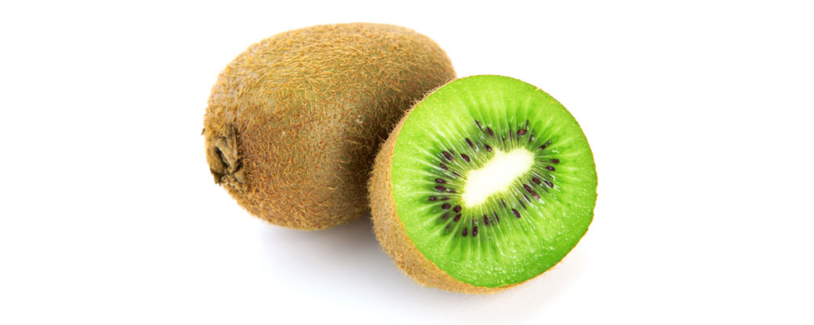
What is it?
It is brown on the outside.
It is green on the inside.
It is round and hairy.
It is small.
It is a soft fruit.
It is a kiwi!

