Slide 1
What IS IT?
Mr Greg’s English Cloud

Slide 2
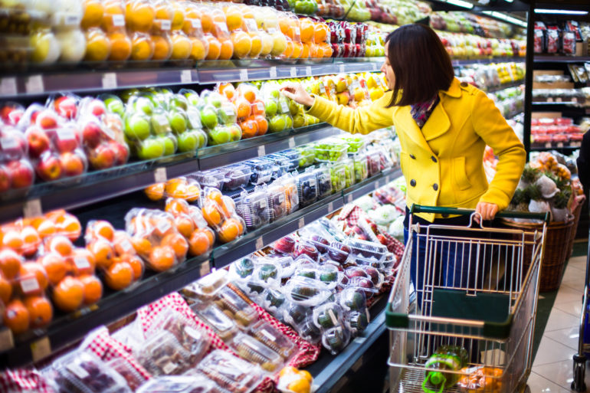
What is it?
It has many different products.
You can buy food here.
It is a big shop.
You can see cashiers.
It is a supermarket!

Slide 3
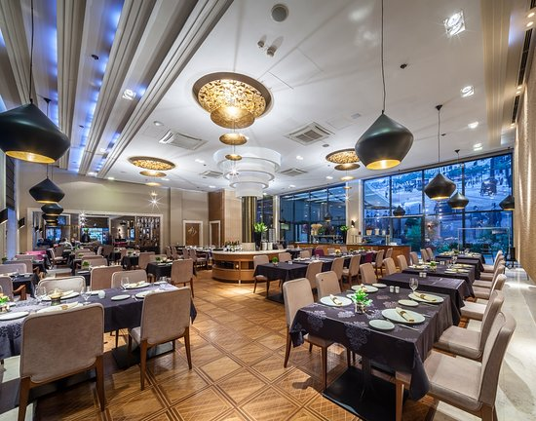
What is it?
It has a menu.
You can talk to a waiter.
You can order food.
You can eat here.
A chef cooks the food.
It is a restaurant!

Slide 4
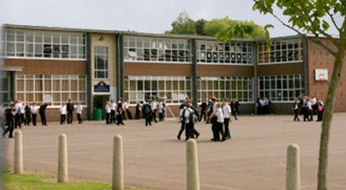
What is it?
It has many classrooms.
You can see teachers.
You learn here.
It is a school!

Slide 5
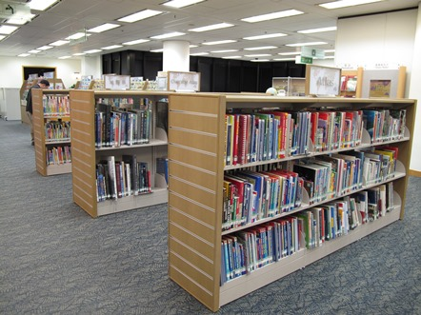
What is it?
It has many books.
You need to stay quiet.
You can see a librarian.
It is a library!

Slide 6
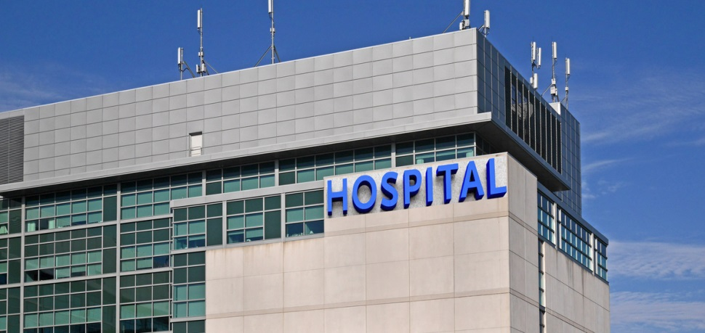
What is it?
It has many doctors.
It has many nurses.
You go there when you are very ill.
You can get medicine from here.
It is a hospital!

Slide 7
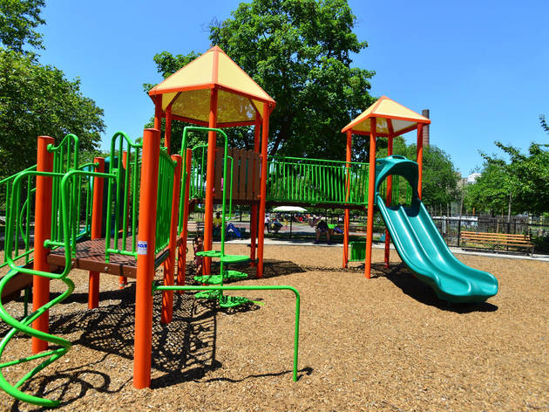
What is it?
This place is outside.
It has swings.
It has slides.
You can have lots of fun here.
It is a playground!

Slide 8
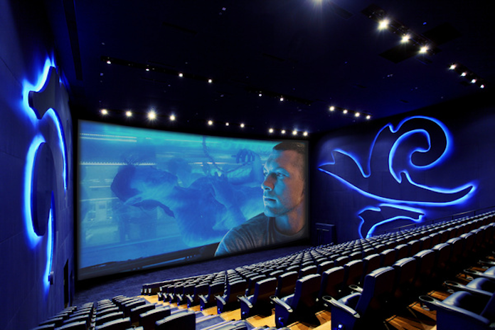
What is it?
It has large rooms with a big screen.
You can watch movies here.
You can buy popcorn and drinks.
It is a cinema!

Slide 9
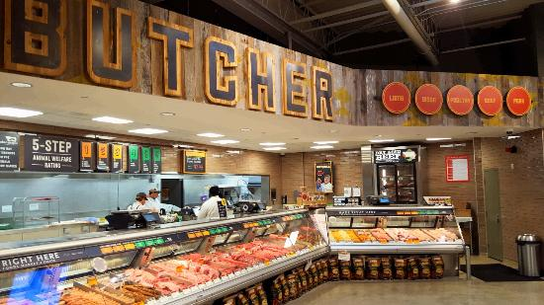
What is it?
It is a shop.
You can buy raw meat.
You can get your meat cut.
It is a butcher!

Slide 10
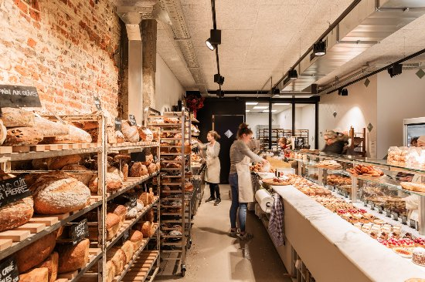
What is it?
It is a shop.
They bake things.
You can buy cakes.
You can buy buns.
It is a bakery!

Slide 11
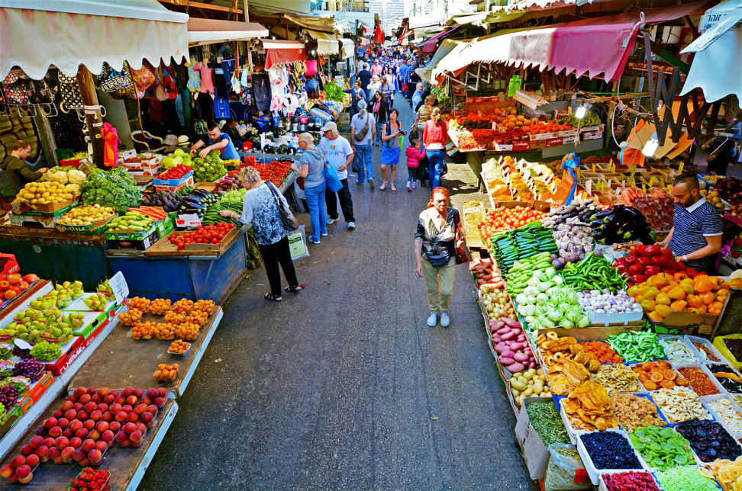
What is it?
It has many open shops.
They sell fruits, vegetables and meat.
All the produce is fresh.
It is a market!

