Slide 1
What IS IT?
Mr Greg’s English Cloud

Slide 2
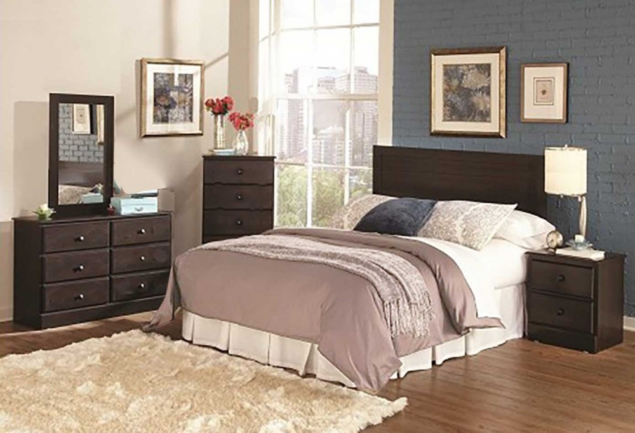
What is it?
You can sleep here.
There is a bed.
There is a wardrobe.
You keep clothes in this room.
It is a bedroom!

Slide 3
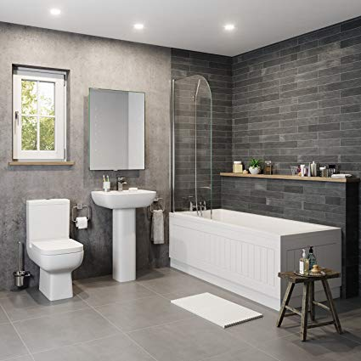
What is it?
You can use toilet.
There is a sink.
There is a shower and bathtub.
You can wash yourself.
It is a bathroom!

Slide 4
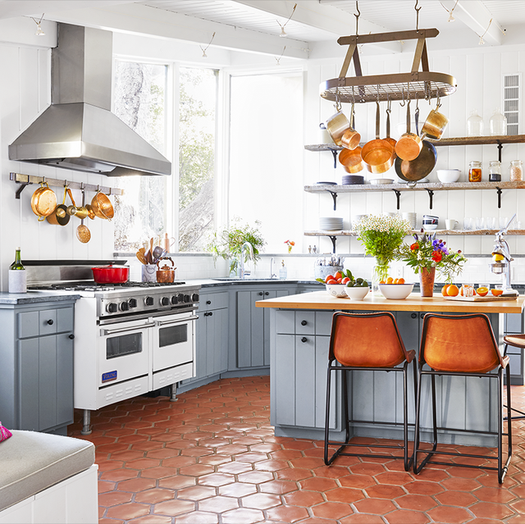
What is it?
You can cook here.
There is a sink
There is a fridge.
You keep food here.
There is a hob and oven to cook.
It is a kitchen!

Slide 5
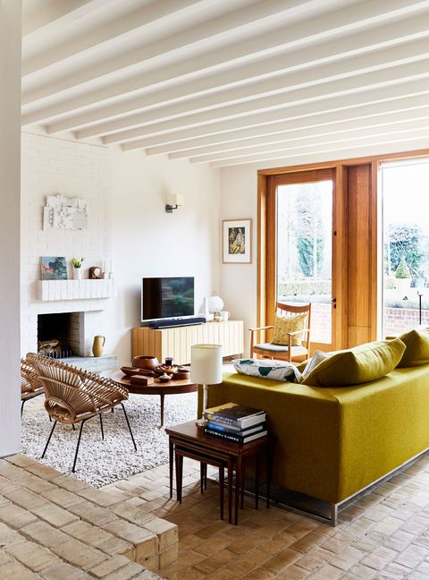
What is it?
You can watch TV.
There is a sofa.
It is a place for family gatherings.
It is a living room!

Slide 6
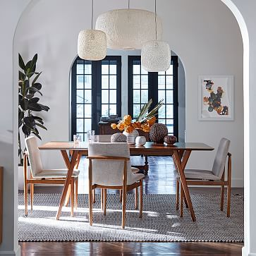
What is it?
You can eat here.
There is a big table.
There are many chairs.
It is a place for family gatherings.
It is a dining room!

Slide 7
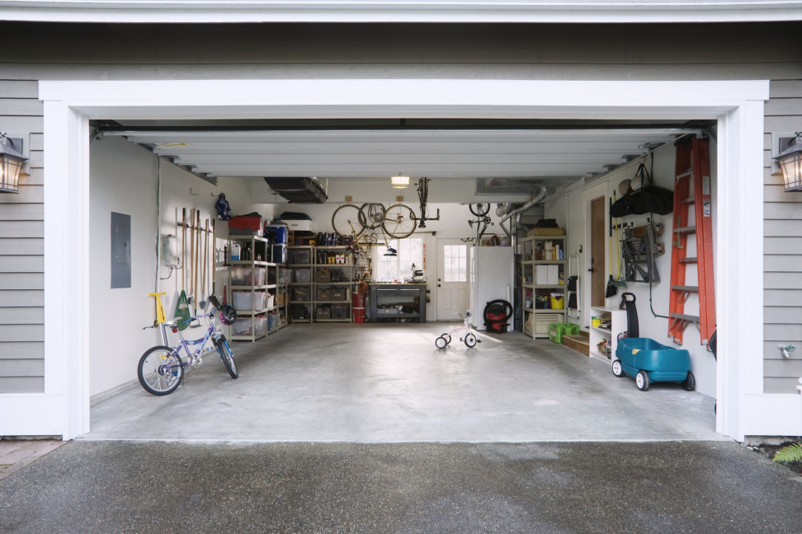
What is it?
You store things here.
You can keep a car in here.
The room can be dark and dirty.
It is a garage!

