Slide 1
What IS IT?
Mr Greg’s English Cloud

Slide 2
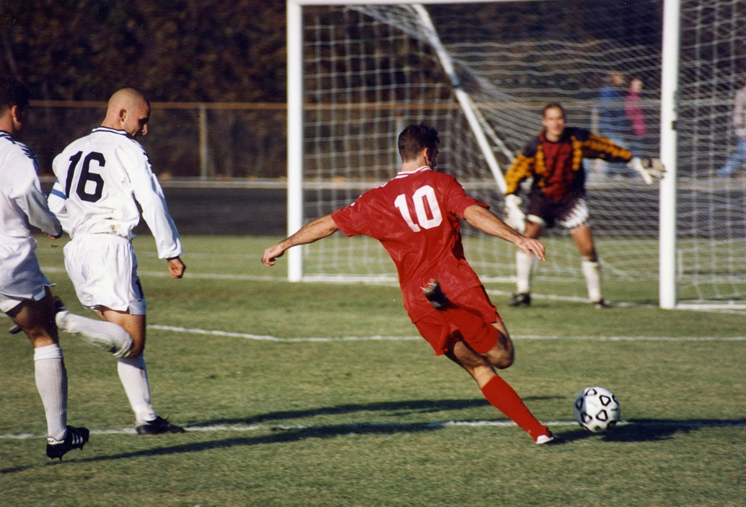
What is it?
There are two teams.
There are eleven players per team.
They kick the ball into a net.
They can’t touch the ball with their hands.
It is football!

Slide 3
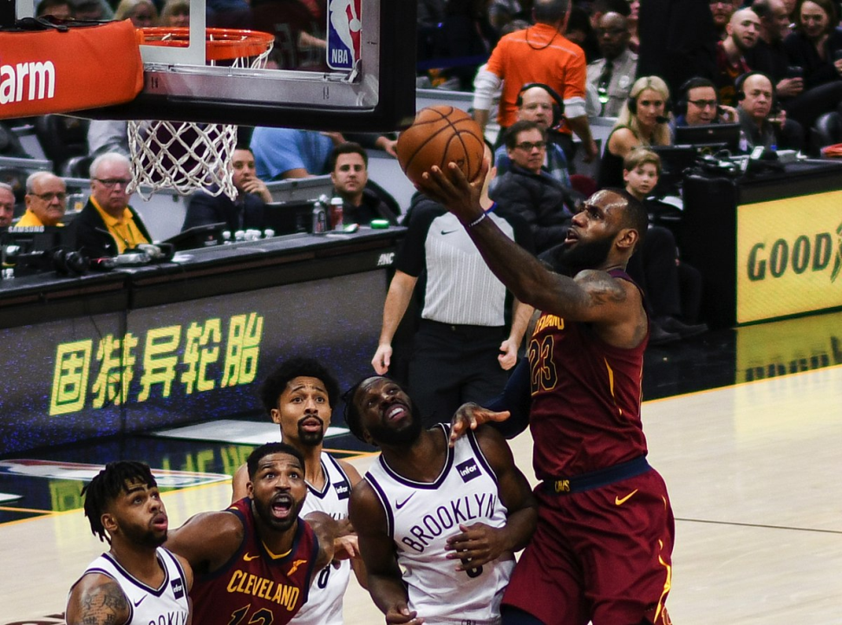
What is it?
There are two teams.
There are five players per team.
They throw the ball into a basket.
They can’t kick the ball.
It is basketball!

Slide 4
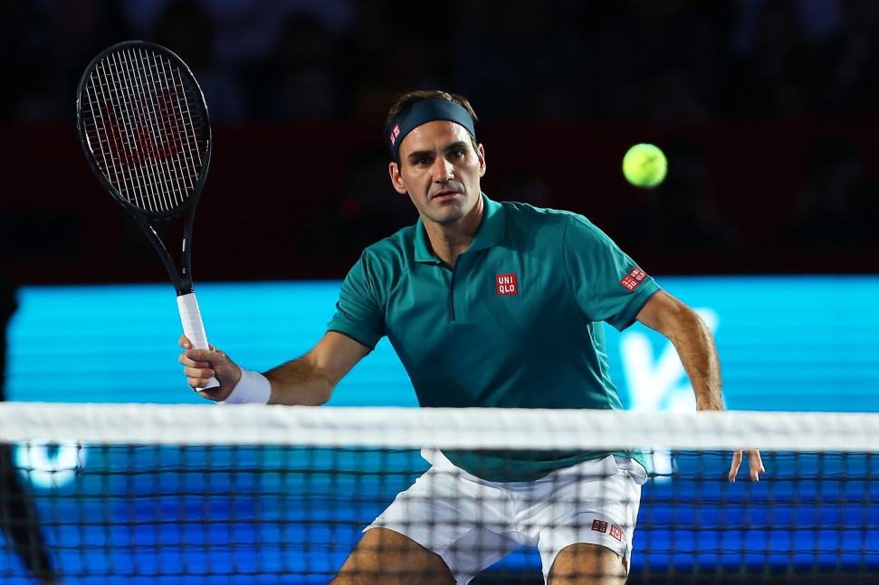
What is it?
There are two or four players.
You can play singles or doubles.
They hit the ball over a net.
They have to hit it with a racket.
It is tennis!

Slide 5
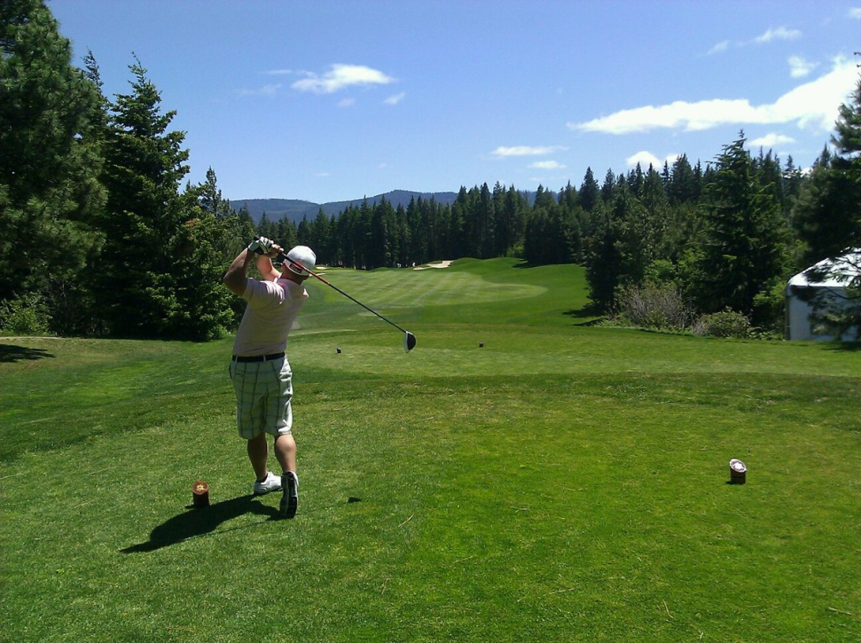
What is it?
You can play by yourself.
You need to get the ball in the hole.
You use a club to hit the ball.
There are 18 holes per course.
It is golf!

Slide 6
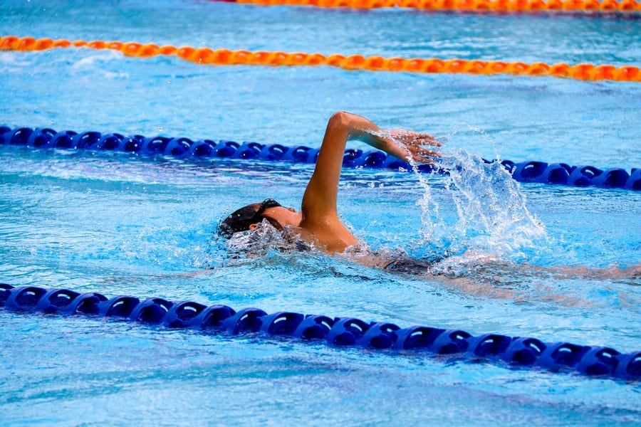
What is it?
You can play by yourself.
You can do this in the sea or in a pool.
You need to move your whole body.
It is swimming!

Slide 7
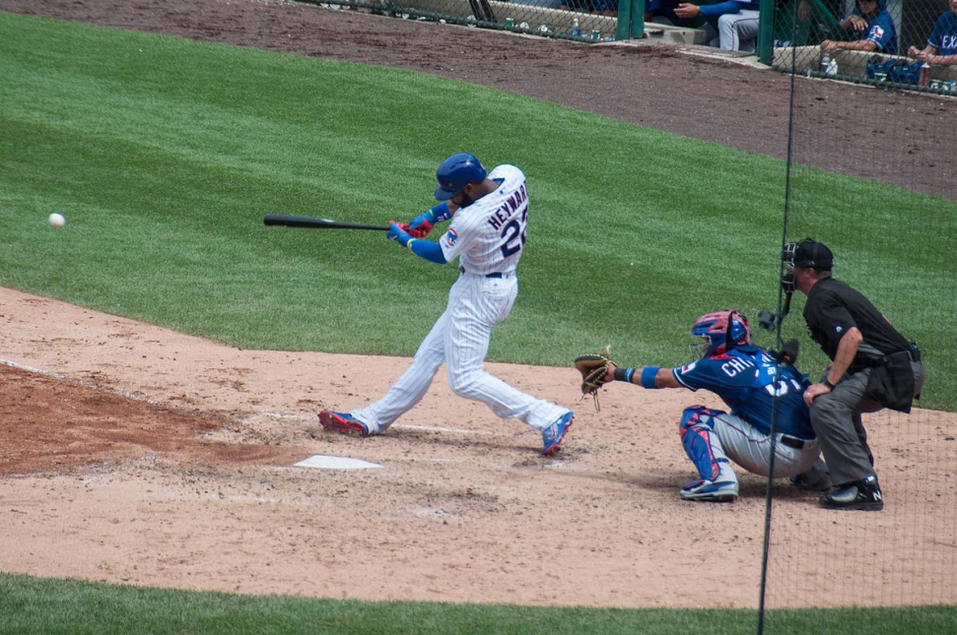
What is it?
There are two teams.
There are nine players per team.
They hit a ball with a bat.
One team throws the ball at a time.
It is baseball!

Slide 8
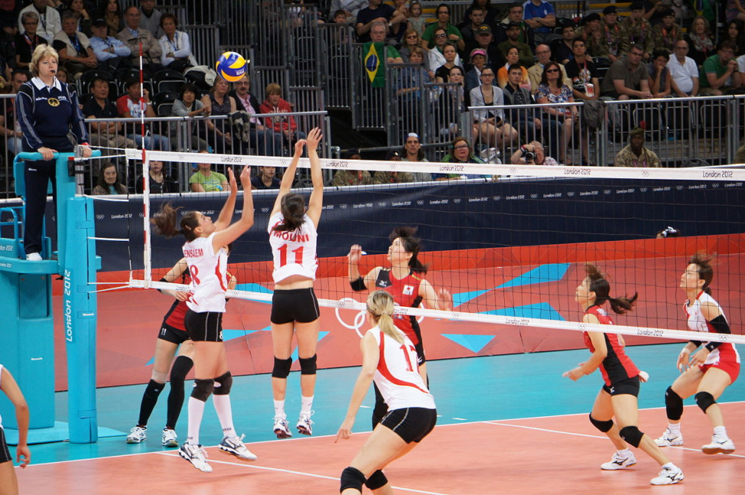
What is it?
There are two teams.
There are six players per team.
They hit the ball over the net.
They can hit the ball with their body.
It is volleyball!

Slide 9

What is it?
There are two teams.
There are 11 players in each team.
They hit a ball into a net.
They hit a ball with a stick.
It is hockey!

