Slide 1
What IS IT?
Mr Greg’s English Cloud

Slide 2
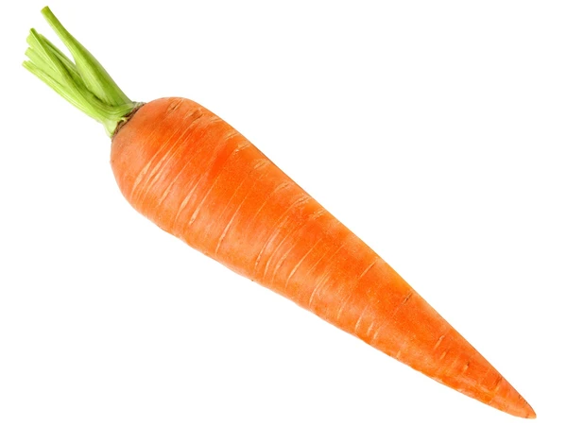
What is it?
It is orange.
It is long.
It grows in the ground.
It is a root vegetable.
It is a carrot!

Slide 3
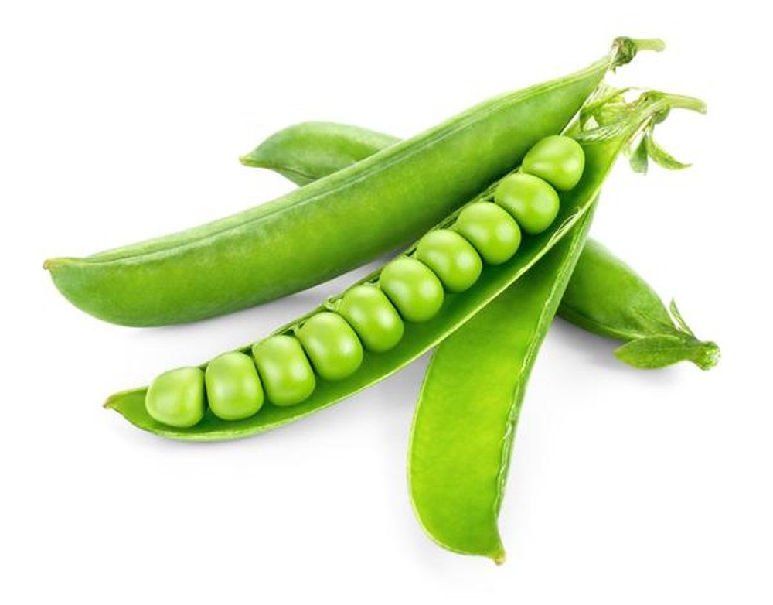
What is it?
It is green.
It is small.
They are shaped like a ball.
It grows in a pod.
It is a pea!

Slide 4
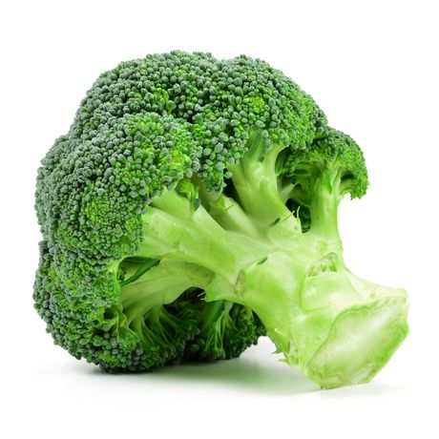
What is it?
It is green.
It looks like a tree.
It grows on the ground.
It is broccoli!

Slide 5
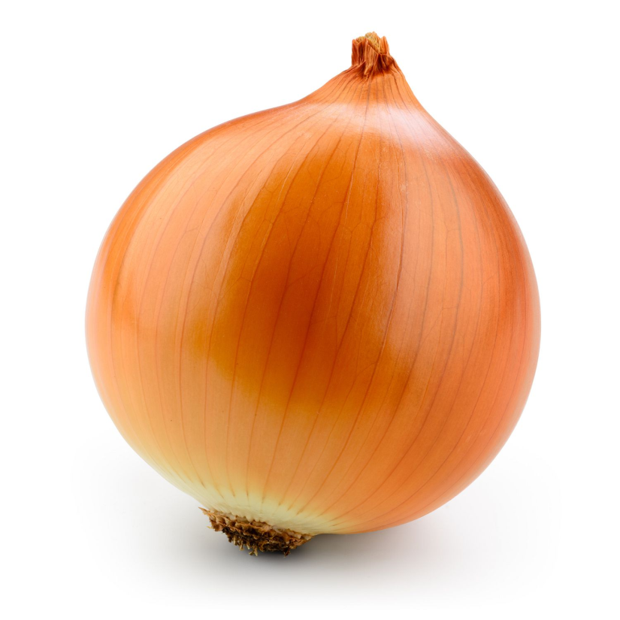
What is it?
It is white.
It has a brown thin skin.
It grows in the ground.
It is a root vegetable.
When cutting it can make you cry!
It is an onion!

Slide 6
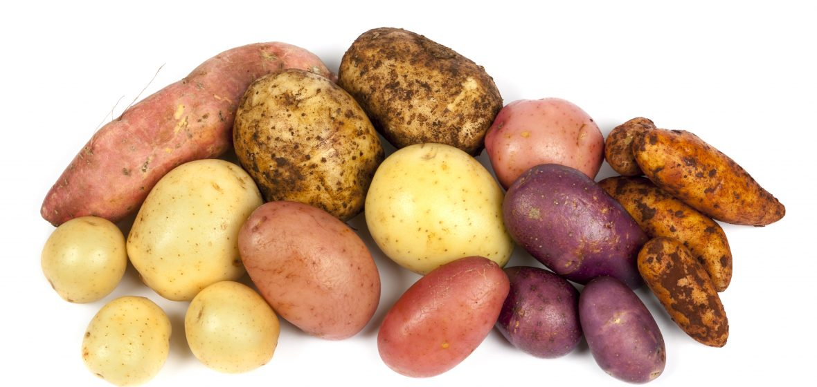
What is it?
It can be white, red or brown.
You can make french fries/chips from it!
It grows in the ground.
It is a root vegetable.
It is a potato!

Slide 7
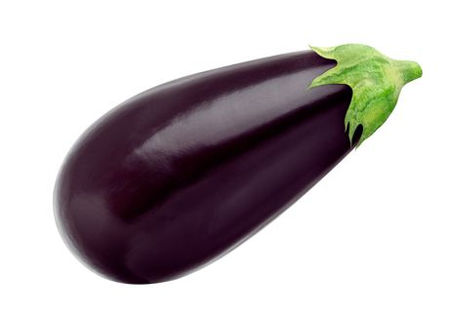
What is it?
It is purple.
It is long.
It is a softer vegetable.
It grows from a plant.
It is an eggplant / aubergine!

Slide 8
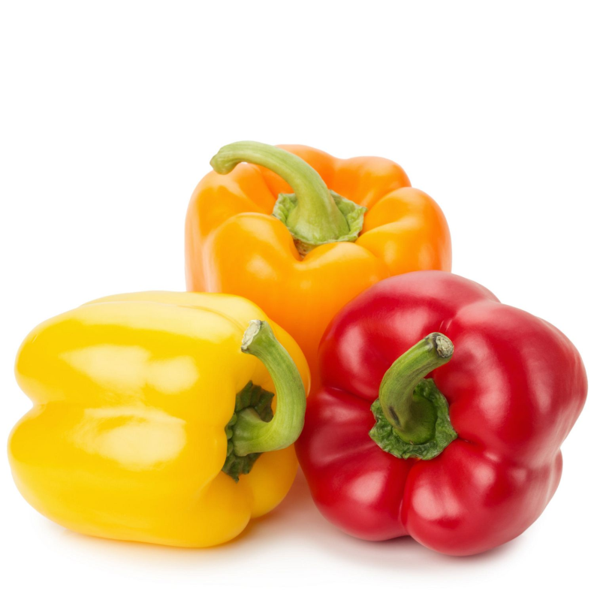
What is it?
It has many different colours.
It is bell-shaped.
It grows from a plant.
It has different flavours.
It is bell pepper!

Slide 9
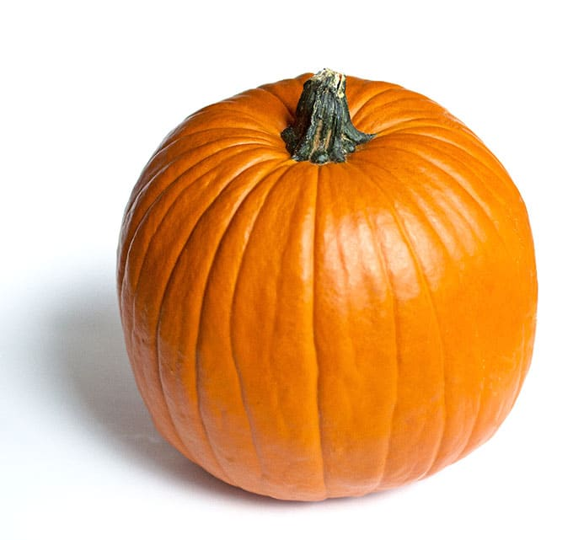
What is it?
It is orange.
It is big and thick.
It is a popular vegetable in autumn and winter.
You can carve it in Halloween.
It is a pumpkin!

Slide 10
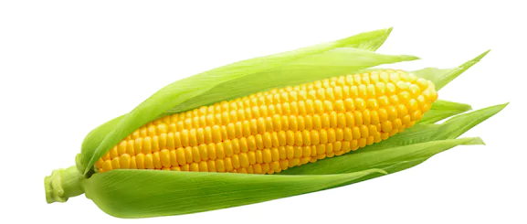
What is it?
It is yellow.
It is small.
It grows on a tall plant.
It is wrapped in leaves.
It is corn!

Slide 11
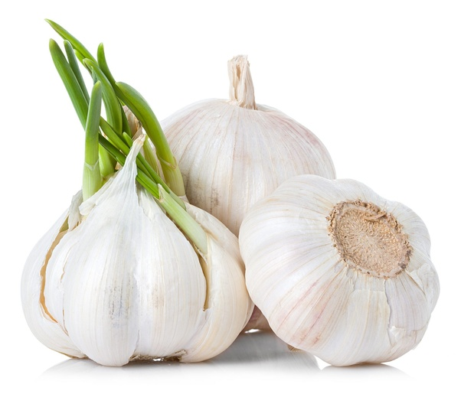
What is it?
It is white.
It has white skin around it.
It has many parts inside it.
It is a root vegetable.
It is garlic!

