Slide 1
What AM I?
Mr Greg’s English Cloud

Slide 2
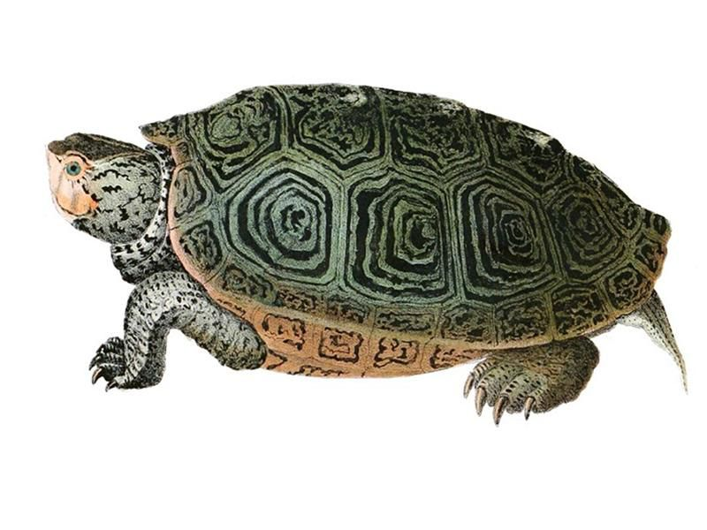
What am I?
I am a reptile.
I am slow.
I have a hard shell on my body.
I have four flippers.
I am a turtle!

Slide 3
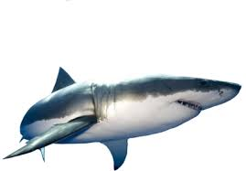
What am I?
I am a fish.
I have a fin.
I swim very fast.
I have a big mouth with sharp teeth.
I am a carnivore.
I am a shark!

Slide 4
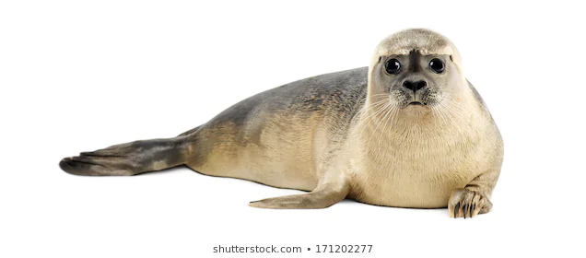
What am I?
I am a mammal.
I am grey.
I have a layer of fat.
I have whiskers.
I can go on land.
I am a seal!

Slide 5
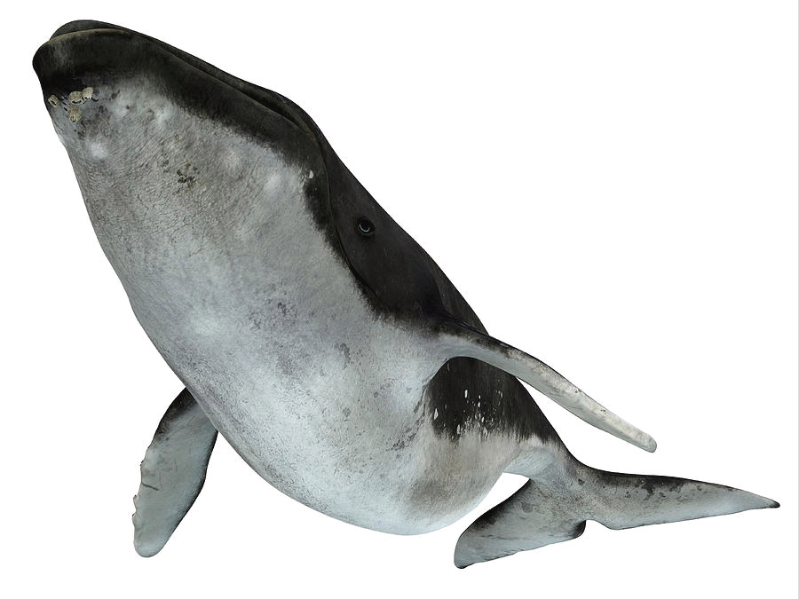
What am I?
I am a mammal.
I am very big.
I can jump out of the sea.
I can make a loud squeaky noise.
I am a whale!

Slide 6
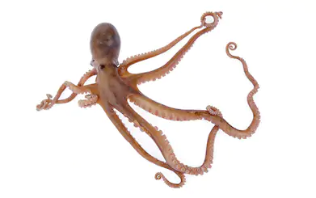
What am I?
I am very soft.
I am very flexible.
I have eight tentacles.
I can squirt ink.
I am an octopus!

Slide 7
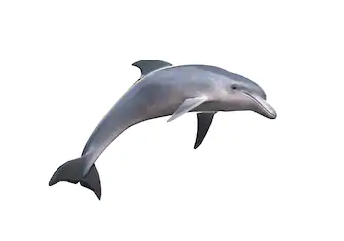
What am I?
I am a mammal.
I have a hole in my head.
I am very playful.
I love to make friends.
I am a dolphin!

Slide 8
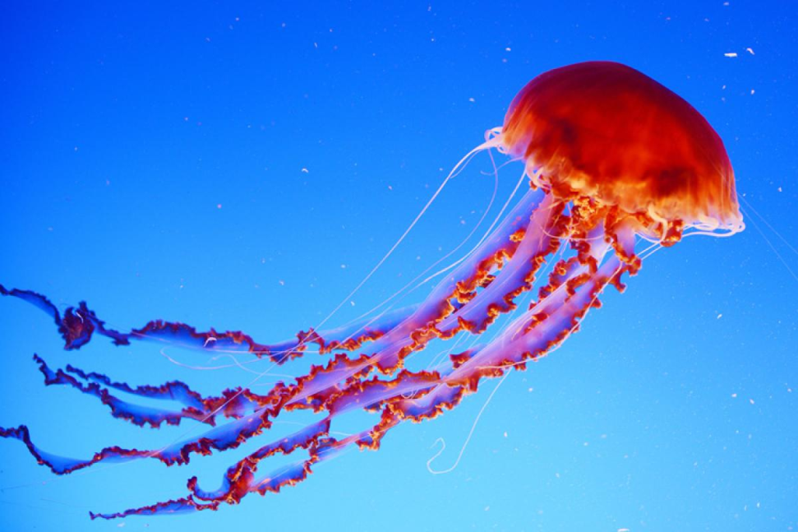
What am I?
I am a fish.
I am very soft.
I have stinging tentacles.
I have no eyes, heart, bones or brain!
I am a jellyfish!

Slide 9
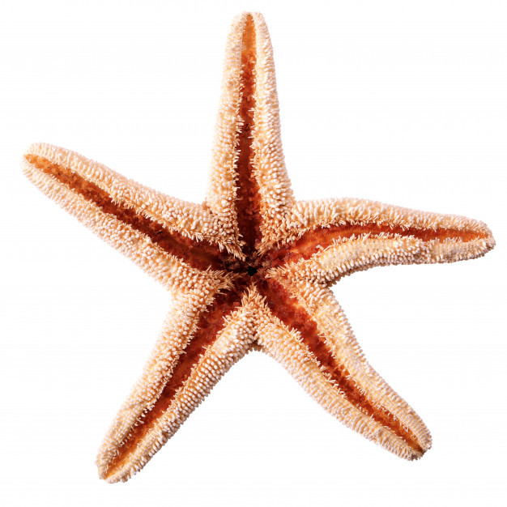
What am I?
I am a fish.
I live on the ocean floor.
I have many suckers.
I am shaped like a star!
I am a starfish!

Slide 10
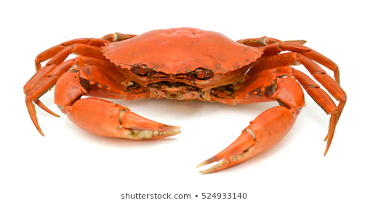
What am I?
I have a thick shell.
I have a single pair of claws.
I have six legs.
I eat what is on the ocean floor.
I am a crab!

Slide 11
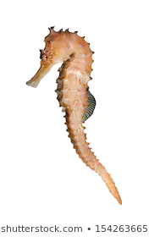
What am I?
I am small.
I can lay thousands of eggs.
The male gives birth.
I am shaped like a horse!
I am a seahorse!

Slide 12
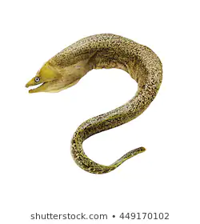
What am I?
I am a fish.
I am very long like a snake!
I like to hunt at night.
I am an eel!

Slide 13
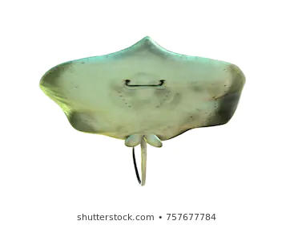
What am I?
I am a fish.
I am grey.
I have a flat body.
I have a tail.
I can sting you.
I am a stringray!

