Slide 1


Kindergarten Adjectives

Slide 2
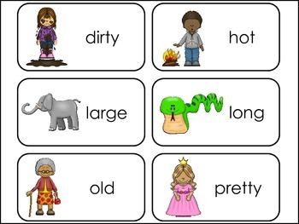
Adjectives are describing words.

Slide 3

Numbers are adjectives.

Slide 4
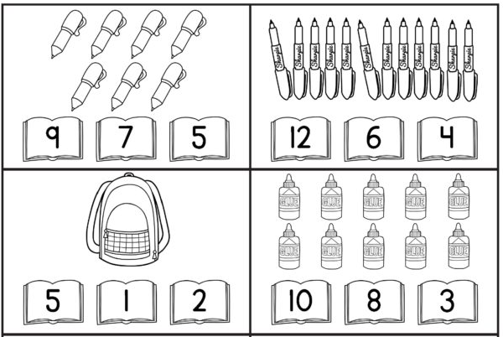
Count. Use ‘there is/are…’

Slide 5
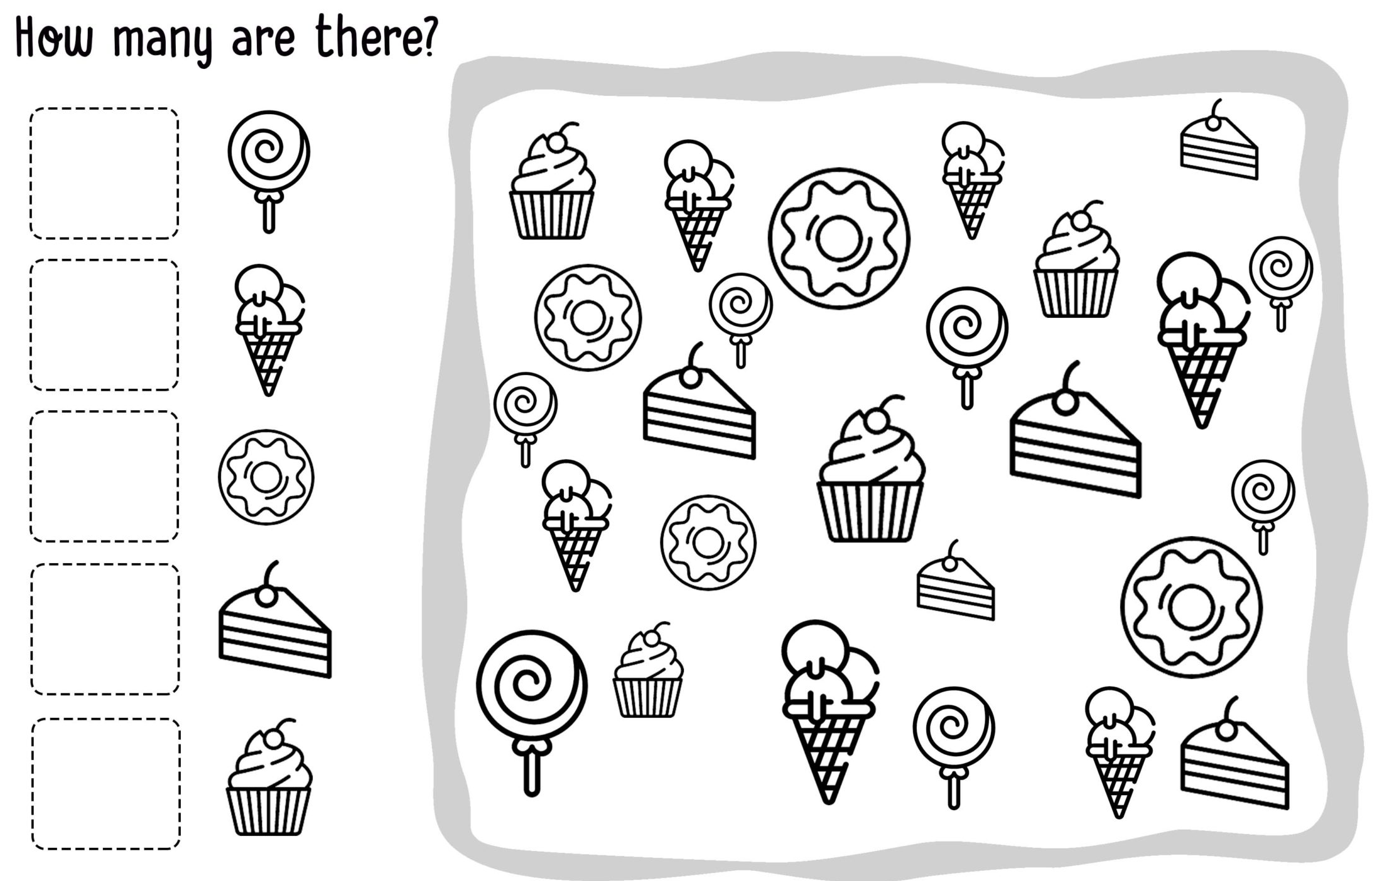
Count. Use ‘there is/are…’

Slide 6
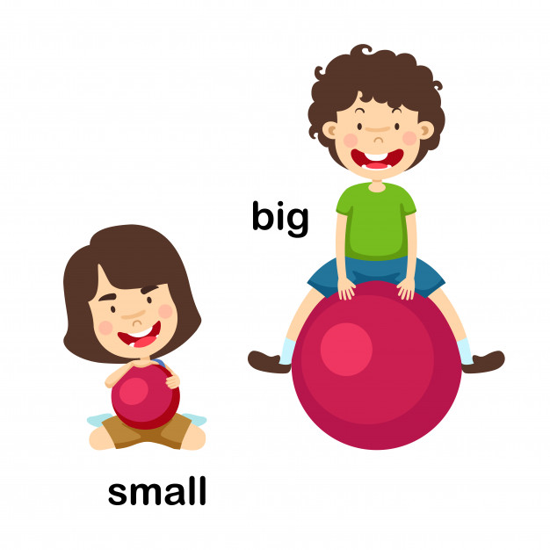
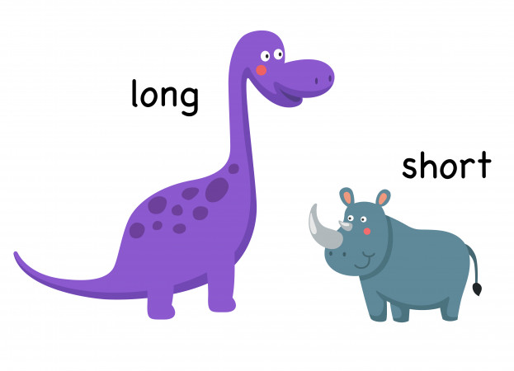
Words that describe size are adjectives.

Slide 7
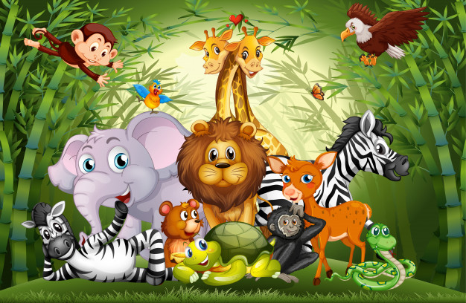
Describe the size of the animals.

Slide 8
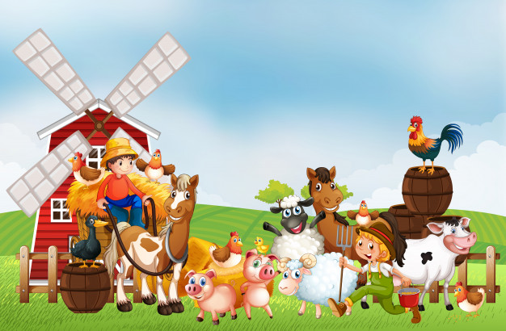
Describe the size of the animals.

Slide 9
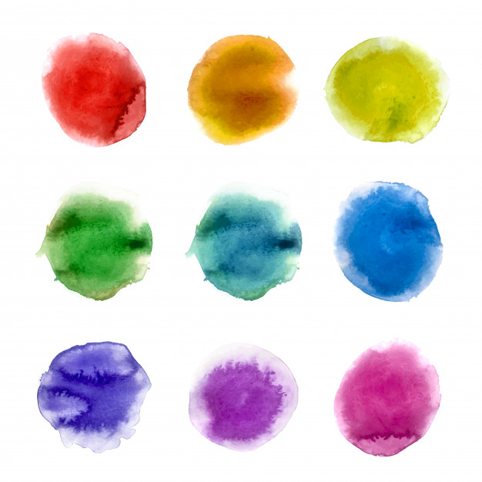
Colours are also adjectives.

Slide 10
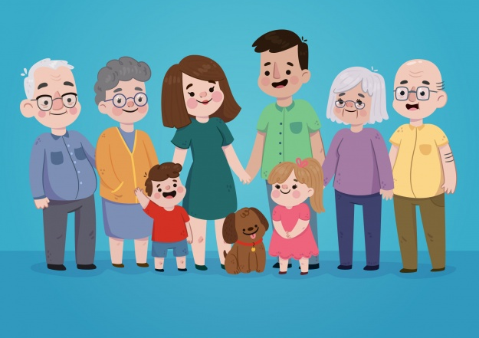
Describe the picture using colours.

Slide 11
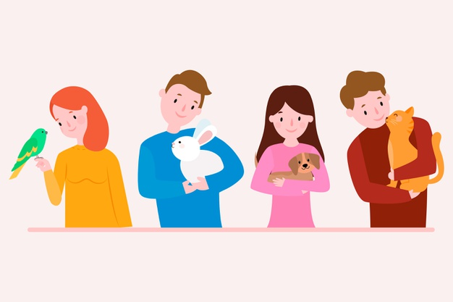
Describe the picture using colours.

Slide 12
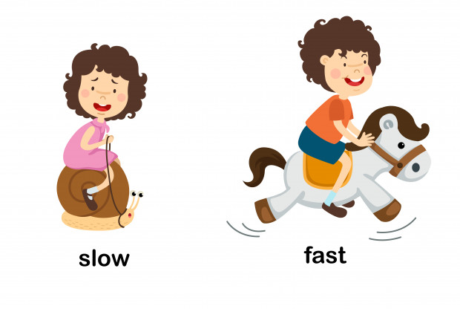
Words that describe movement are adjectives.

Slide 13
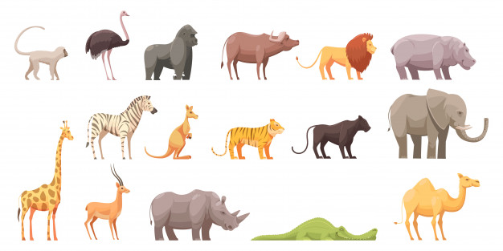
What animals are fast/slow?

Slide 14
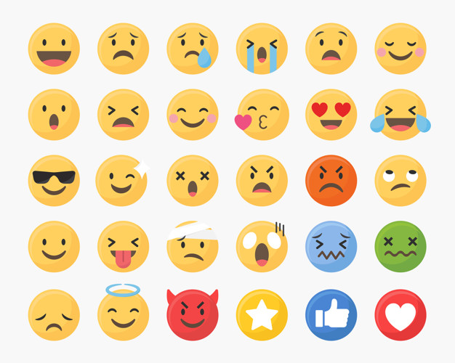
Emotions are also adjectives.

Slide 15
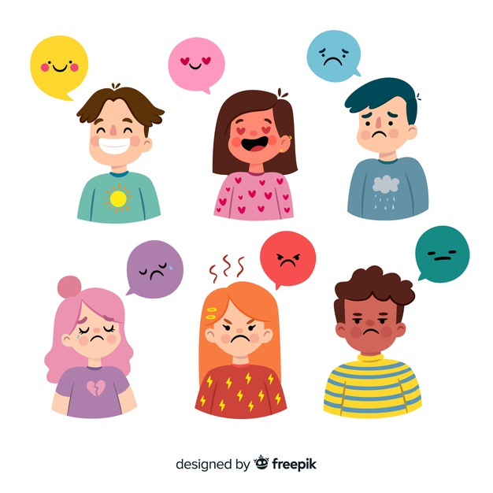
Describe the emotions. Use full sentences.

